Slide 1
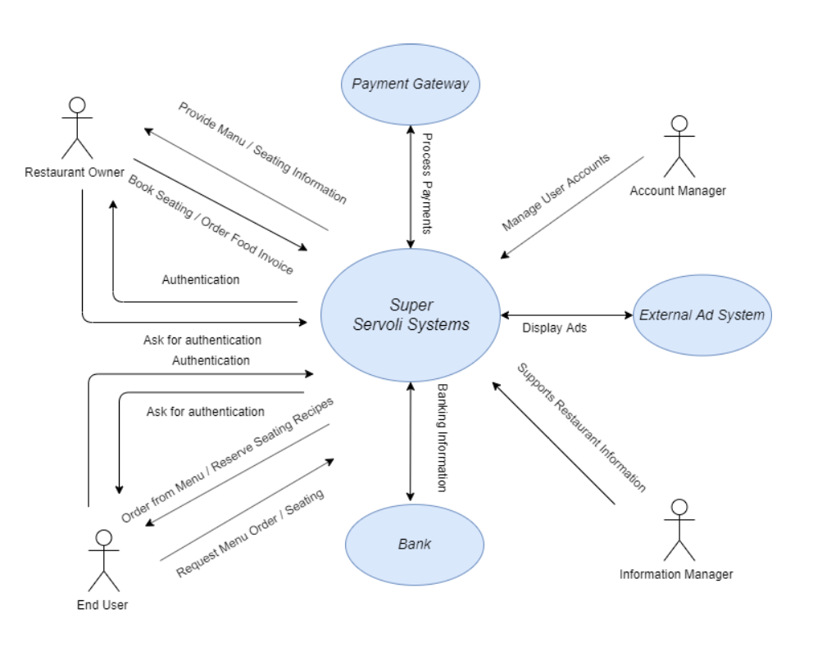
Super Servoli System Context Diagram

Slide 2
System Interface Table
Description | Source | Target | Frequency | Validation
Process Payments | Payment Gateway | Super Servoli System | Real-time | Orders processed will have final price match the sum of all selected menu items.
Displays Ads | External Ad System | Super Servoli System | Real-time | Ads will rotate and display while users are browsing the application
Banking Information | Bank | Super Servoli System | Real-time | Validates transactions with external banks

